Slide 1


Slide 2


Building Complex, Dynamic, and Flexible Multi-Step / Wizard Forms
Cary Mayeda
cmayeda@childrenscoloradofoundation.org

Slide 3
Building Complex, Dynamic, and Flexible Multi-Step / Wizard Forms
A look into how a custom framework and the Custom UI Model data form can be leveraged to improve UX and user efficiency in completing forms with large and complex data sets

Slide 4
Background
We had a large, complex legacy form used outside of CRM, which had many dynamic sections and fields. In the simplest case the data entry is fairly minimal, while the more complex cases required a wide range of data entry object types.
Easy and intuitive UI to minimize need for training while increasing staff efficiency
Reduce confusion by only showing necessary data elements/sections
Allow simplest cases to be completed quickly
Allow for sections that are either dependent on or independent of other sections
Easy to modify/maintain
Disclaimer: This is a 1.0 product.

Slide 5


So how did we do?

Slide 6



_____
This has made an otherwise poop like morning quite wonderful.
_____

Slide 7
_____
Omg – I actually did just scream a little.
_____

Slide 8
_____
It's really been a smooth transition and a great UX even in its version 1 form
_____

Slide 9
Demo

Slide 10
Alternate solution Blackbaud Wizard Form

Slide 11
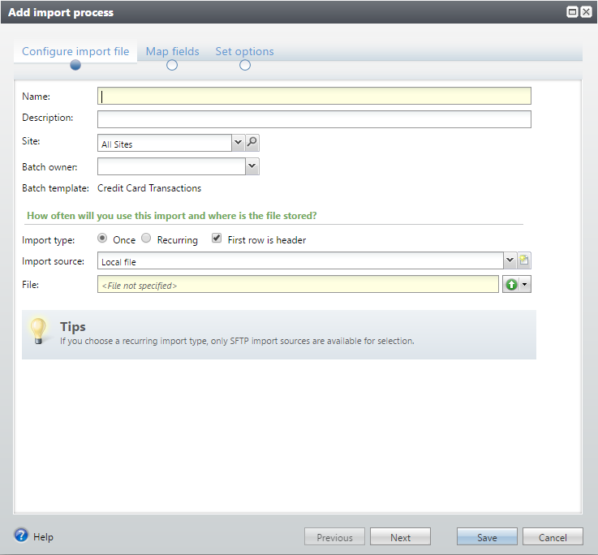
What about the Blackbaud Wizard form?
Notes:
In case you weren’t aware, Blackbaud has a pattern to transform a standard form into a wizard.
This is the “Add Import Process” form using that pattern
It’s very useful for multi-step forms with fewer fields and less complexity

Slide 12
What about the Blackbaud Wizard form?
Great post by Trip Ottinger explaining how to leverage the "Guided User Experience" pattern.
http://www.bbdevnetwork.com/qa/41588/how-do-i-implement-a-wizard-ui-in-an-infinity-application
Because it’s a standard add/edit form with an altered UI it has the same UX challenges when the number of fields increases.
All data needs to be entered and valid before saving
Unsaved data in CRM “popup” forms are lost if the user session times out
Maintenance is more difficult for very large forms, since it is all in a single object.
Notes:
Trip Ottinger has a great post on BBDevNet explaining how to leverage the “Guided User Experience” pattern
Because it’s essentially a standard CRM form with an altered UI, it has the same UX challenges for any CRM Add/Edit form with large, complex data sets
Here are the main challenges we ran into that swayed us into creating our own
** All data needs to be entered and valid before saving the form.
We anticipated that users may not have all the information necessary to complete the form in a single session.
This would quickly become a point of frustration if they entered some data and ran into a roadblock and they had to start over again.
You might say that they could just leave the form up and come back to it at a later time.
** However, CRM “popup” forms disappear along with all their data if a user’s session times out or an app pool recycle occurs
I don’t know about you, but I know I’ve had the following scenario happen to me – especially early on in my usage of the CRM web shell.
You’re creating a new query in CRM.
You’ve gone down a hundred rabbit holes trying to find the correct sub node of a sub node of a sub node
You’re almost done when you get an important call
You hurriedly click save and take the call
After the 20 minute call is done you look back at your screen and CRM has timed out.
Bye bye query
Everything you’ve done for the past ½ hour is gone.
Why?
Because you forgot that this was a new query and you hadn’t entered a name for the query, so the form didn’t actually save, because it didn’t pass validation.
Your query and everything associated with it is gone
We didn’t want this to happen to the users of our form.
** The last major reason we went a different direction was maintainability.
Maintenance is more difficult for very large forms, since it is in a single object. Therefore making it more difficult for junior level developers to create and maintain individual tabs with complex behavior
Our solution is much more modular in nature and therefore a lot easier for a Junior Programmer to modify a small portion of it or to add functionality

Slide 13
Design Overview How does it work?

Slide 14
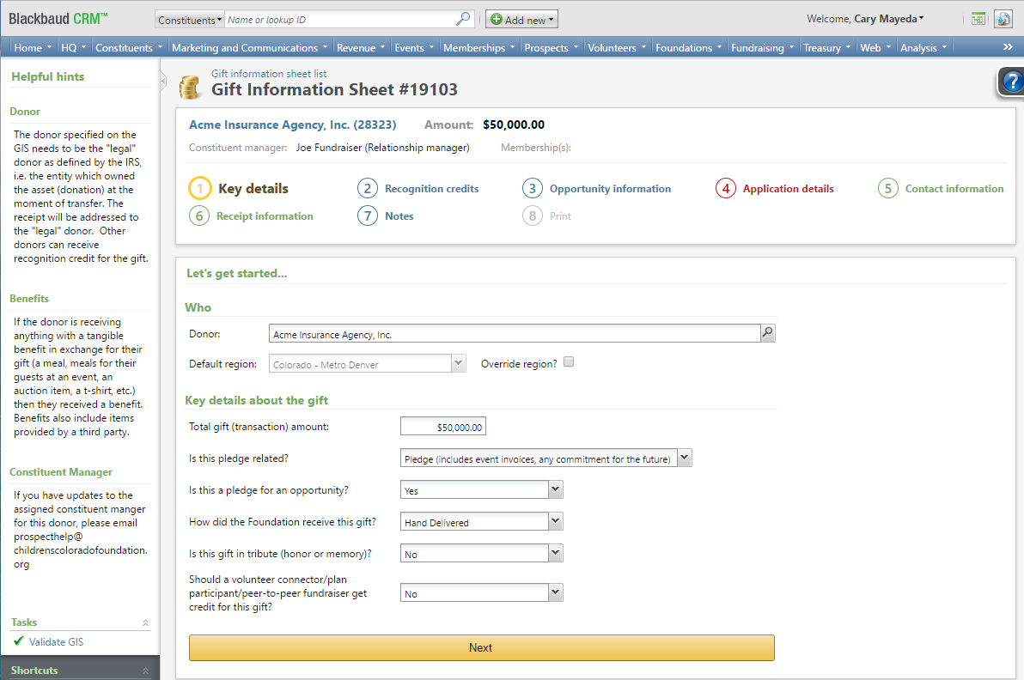
Page Anatomy
Notes:
Our form is all contained in a single page. It’s the same page for all steps.
**Let’s look at the Query String
**Here is the page id
**Here is the record id or page context id
It’s a compound key which stores
** the ID of the record being displayed
** the ID of the Step to display.
The IDs are separated by a comma, which is 2C in hex
To facilitate moving from one step to another, we navigate to the same page and just change the Step ID portion of the page context id

Slide 15
Page Anatomy
Explorer Bar Section
Summary Section
View Data Form
Custom UI Model
Tab Section
Custom UI Model
Notes:
What are the different objects that make up our page?
The top section is the standard Summary Section of the page containing a single Custom UI Model data form
**The bottom section is the standard Tabs section.
We only show the Tab that corresponds to the current Step and hide all others
This simplifies the UI since the tab UI is never visible
On this tab we have another Custom UI Model data form
We’ll explore this more later, but I just want to mention that we went with a Custom UI Model data form to allow the user to enter data directly into the form instead of having to click add/edit actions; again simplifying the UI
The other thing to note is that any CRM objects that can be displayed on a tab can be utilized here as well.
Data lists, list builders, view forms, actions, …
** The “Helpful hints” section is an Explorer Bar Section that displays a View data form in order to pull the hints specific to the Step or Tab being displayed.
NOTE: We use the terms Step and Page interchangeably to reference what is displayed when you are on a specific Step of the form. Initially we were going to have each Step contained in a separate CRM Page, but then landed on the current design of a single page with the Steps on tabs. I apologize for the confusion now that this may cause.

Slide 16
Deeper Dive How does it work?

Slide 17
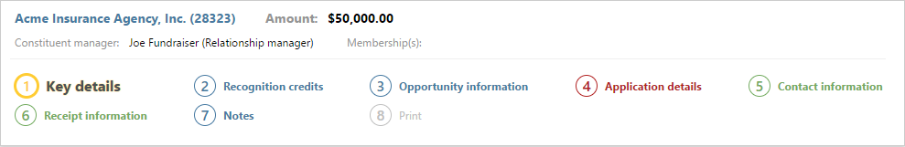
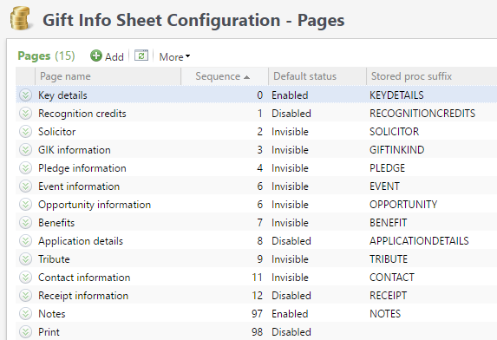
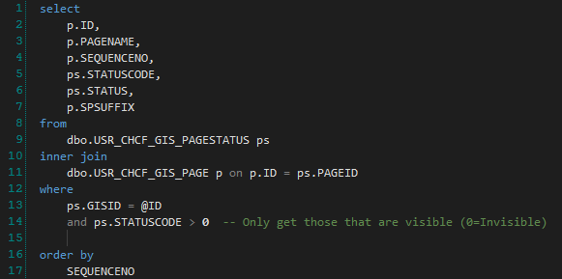
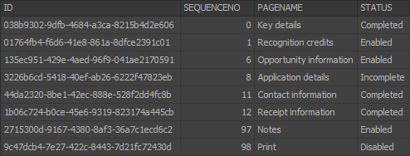
The Custom UI Model data form in the Summary Section
Summary Section
Custom UI Model
Notes:
Let’s take a look at the Custom UI Model data form used in the Summary Section
This is a single Custom UI Model data form
**The top half is rendered similarly to a UI Model for a View data form
**The bottom half is
Data & Configuration driven
Dynamically rendered
Data/Configuration driven
** the Order, Captions, and Initial State of the Steps are based on Configuration Data & Forms that we created for a configuration admin to maintain
** Every time the page is rendered, we call a sproc that returns the list of Steps to display. It pulls from the table managed by the configuration on the left (USR_CHCF_GIS_PAGE) and a custom table (USR_CHCF_GIS_PAGESTATUS) that contains the current status of each Step/Page
** As you can see from the result set,
The ID used in the compound Page Context ID for the Step
The SEQUENCENO column, which comes from the configuration on the left, determines the order the Steps are displayed
It is NOT the Step Number in the circles. That is dynamically generated, since the number of Steps is dynamic
The PAGENAME column (also from the configuration) is the Caption of the Step
And the STATUS column determines the Color of the Step and whether the Step is enabled. This comes from a custom table USR_CHCF_GIS_PAGESTATUS
Dynamically rendered
The Page Header actually consists of 15 sets of objects – 1 set per Step.
These are rendered each time the CRM Page is loaded by the code behind of the Custom UI Model data form based on these results.
In this case only 8 are used and the other 7 are hidden.
NOTE: It should be noted that this could have been a UI Model View form, but initially we didn’t have any summary data, just the Steps, so I started with the Custom UI Model.

Slide 18
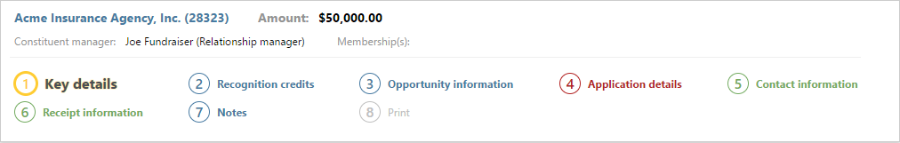
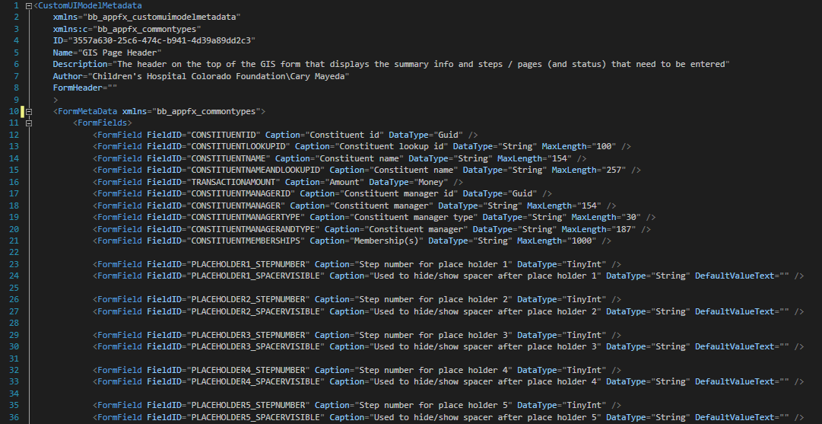
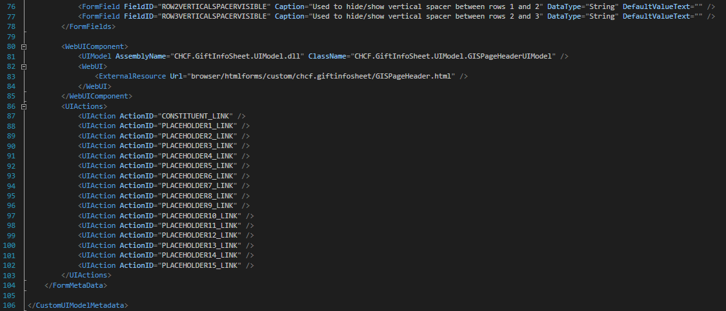
The Custom UI Model data form in the Summary Section
Notes:
**Let’s take a look at the Spec for the Custom UI Model data form
** This first section is like any form spec and controls the top of the header
** The next section are placeholders for the Step Number and the Spacer or Gap between Steps for the first row.
There are a total of 15 sets of Step placeholders to allow for up to three rows of Steps.
** If we look farther down in specs past the 15 sets of Step Numbers and Spacers
**We’ll see some vertical Spacers
The reason for all the Spacer fields is that the containers for these fields can be used to remove the vertical space when not needed and remove extra gaps at the bottom of the header when only one or two rows of steps are displayed
** The WebUIComponent node is the same as any other data form with a UI Model
** Lastly, we have the UIActions
The first one is used to create a link on the Constituent Name to the Constituent Page
The rest of the UI Actions are for the Step Captions as they are clickable.
DID ANYONE CATCH THE PRIMARY DIFFERENCE between Custom UI Model data forms and other data forms?
Let’s take a look again at the beginning of the spec file

Slide 19
The Custom UI Model data form in the Summary Section
Notes:
Let’s take a look again at the beginning of the spec file
Custom UI Model data forms do not have associated stored procedures. All data retrieval and saving is done within the code behind.

Slide 20
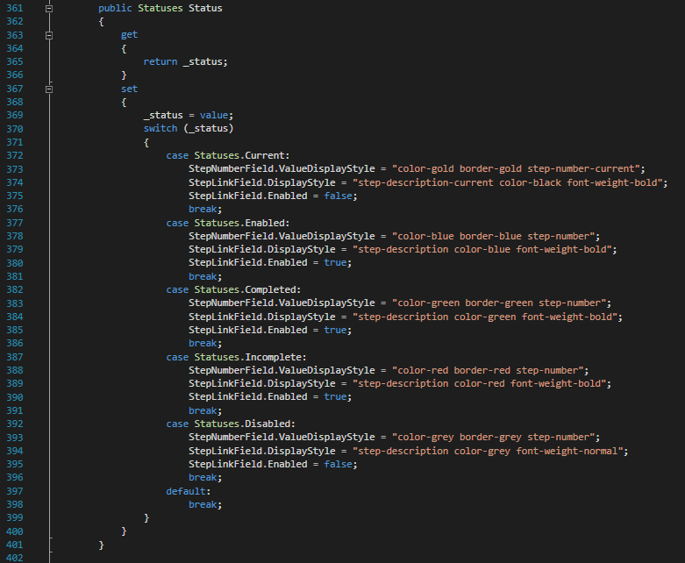
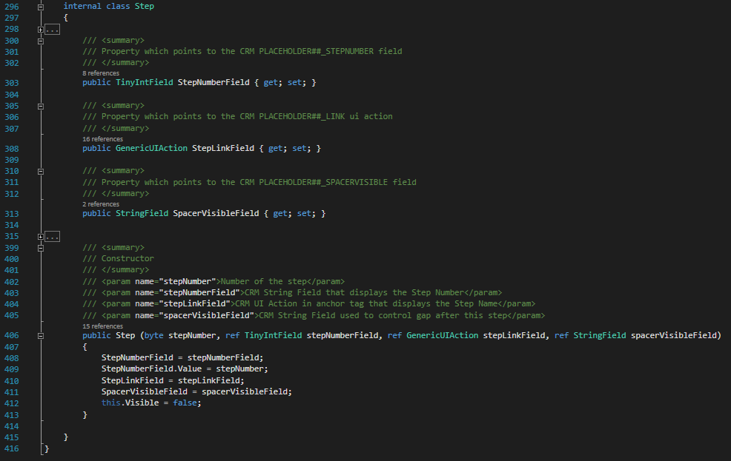
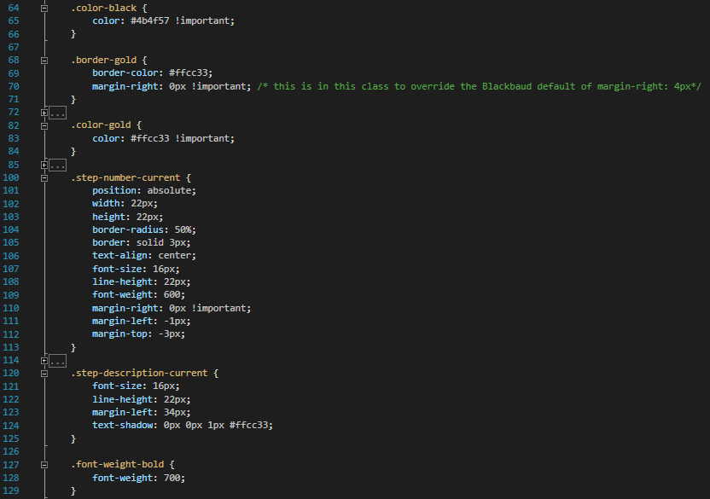
The Custom UI Model data form in the Summary Section
Notes:
Speaking of code behind. What does the code behind for the GIS Page Header spec look like?
** First let’s look at how a single step is rendered.
** We created an internal class to manage each Step in the header. Here are the Properties which reference the UI Model Objects associated with the Step.
**The Step Number field
**The Step UI Action
**and the Spacer field
**We set the references in the constructor of the Step class.
Note that the Value of the Step Number is set here as well.
**Another property in this class contains the Status of the Step
The Setter on the Status property is where the styles are applied to each step by using
the ValueDisplayStyle property on the Step Number field
and the DisplayStyle property on the UI Action
So that when the page is rendered the appropriate CSS Classes are assigned to the objects’ corresponding html element
Let’s focus on the Key Details Step.
**The Status is Current so we:
**Assign these CSS classes to the Step Number Field
to set the color to gold, have a circular gold border, and a font size of 16px.
** Assign these CSS classes to the Step UI Action
To set the color to black with a bold font weight, a font size of 16px, and a gold text shadow
** Lastly, we disable the UI Action so that the user cannot click the link, since it is the current Step.
Note that in some cases we have needed to use the !important rule to force a style

Slide 21
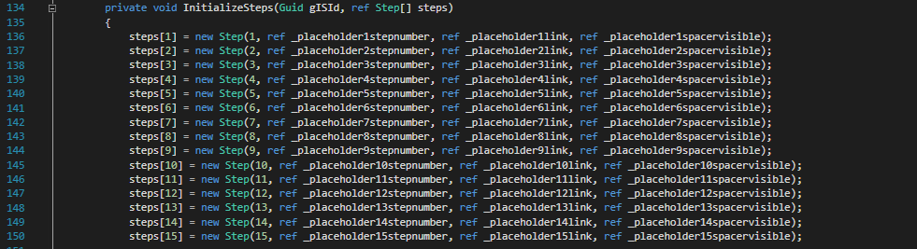
The Custom UI Model data form in the Summary Section
Notes:
Now that we understand how the Step class works, we can turn our attention to the Loaded event handler for the Custom UI Model data form
Here we create an instance of a helper class, which among other things parses the context record id into its two parts.
Then we call a method that initializes all the step objects passing it the true context id (GISId)
**We use an array to hold one instance of the Step class we just reviewed for each of the 15 possible steps

Slide 22
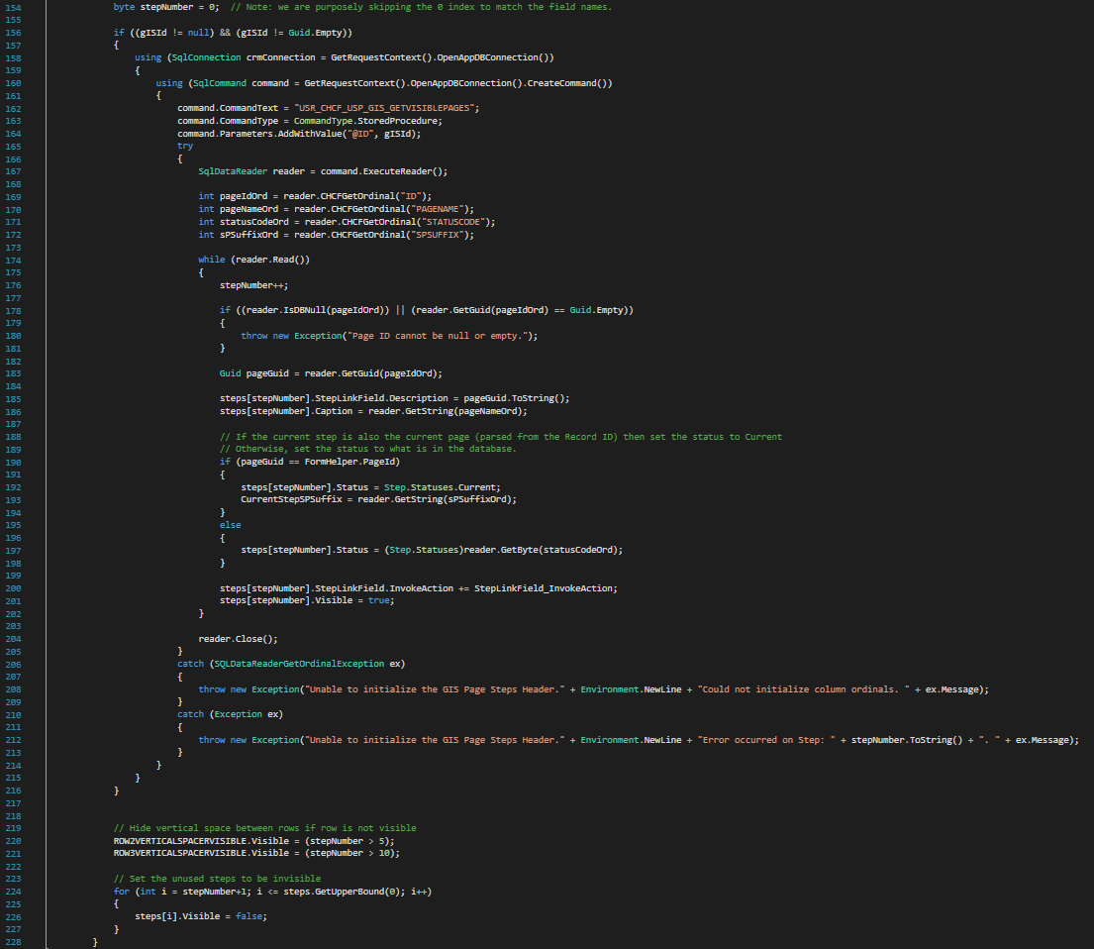
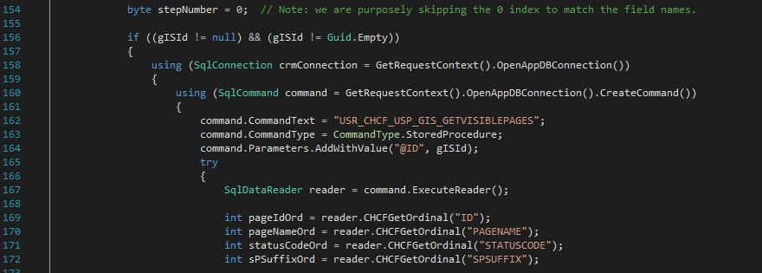
The Custom UI Model data form in the Summary Section
Notes:
Here is the rest of the IntializeSteps method
**After we initialize the Steps array,
**We find the Steps that should be displayed by calling the GETVISIBLEPAGES sproc.
This is the sproc we discussed earlier.

Slide 23
The Custom UI Model data form in the Summary Section
Summary Section
Custom UI Model
Notes:
Which returns the list of visible Steps and their statuses

Slide 24
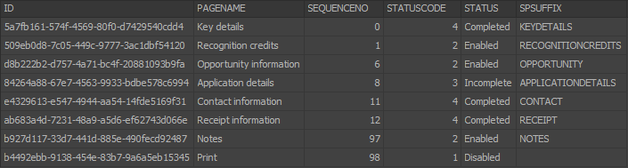
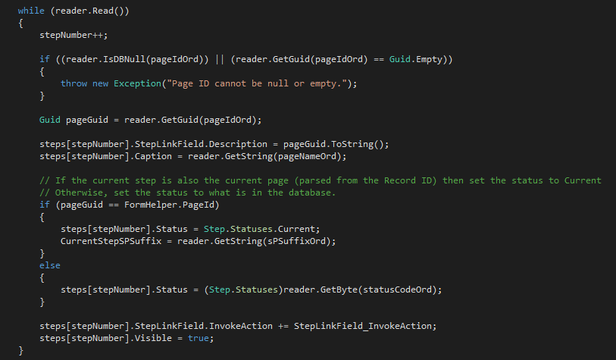
stepNumber = 0
stepNumber = 1
The Custom UI Model data form in the Summary Section
pageGuid = null
pageGuid = 5a7fb161-574f-4569-80f0-d7429540cdd4
CurrentStepSPSuffix = String.Empty
CurrentStepSPSuffix = “KEYDETAILS”
steps[1].StepLinkField.Description = String.Empty
steps[1].StepLinkField.Description = “5a7fb161-574f-4569-80f0-d7429540cdd4”
steps[1].Caption = String.Empty
steps[1].Caption = “Key details”
steps[1].Status = Disabled
steps[1].Status = Current
steps[1].StepLinkField.InvokeAction = null
steps[1].StepLinkField.InvokeAction = pointer to StepLinkField_InvokeAction
steps[1].Visible = false
steps[1].Visible = true
Notes:
This is the section that processes the results of the sproc
** Let’s put the result set up here as we look at the while loop
** And a watch window
** We increment the StepNumber which now = 1
** We read the Page ID, which = 5a7…
** We set the Description property of the StepLinkField of Step 1 to the Page ID
This property is not displayed nor utilized by the UI Action
However, we use it to store the Page ID so we can navigate to the proper Step when this UI Action is clicked.
We’ll look at how this is used in a minute.
** Next we set the Caption
Caption = Key details
** Check if we are on the current page (If the page /step we are reading = the current page)
** Let’s look at the query string at our record id.
** It does match, so let’s set the Status of this step to Current.
** And set the CurrentStepSPSuffix property to the SPSUFFIX returned. We’ll see how this is used in a minute
** We set the Handler for the UI Action to the StepLinkField_InvokeAction method
** And make the Step visible.
Let’s do one more iteration of the while loop

Slide 25
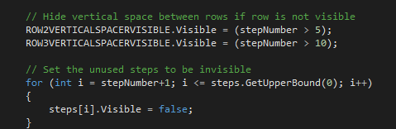
stepNumber = 1
stepNumber = 2
The Custom UI Model data form in the Summary Section
pageGuid = null
pageGuid = 509eb0d8-7c05-449c-9777-3ac1dbf54120
CurrentStepSPSuffix = “KEYDETAILS”
CurrentStepSPSuffix = “KEYDETAILS”
steps[2].StepLinkField.Description = String.Empty
steps[2].StepLinkField.Description = “509eb0d8-7c05-449c-9777-3ac1dbf54120”
steps[2].Caption = String.Empty
steps[2].Caption = “Recognition credits”
steps[2].Status = Disabled
steps[2].Status = Enabled
steps[2].StepLinkField.InvokeAction = null
steps[2].StepLinkField.InvokeAction = pointer to StepLinkField_InvokeAction
steps[2].Visible = false
steps[2].Visible = true
Notes:
** We increment the StepNumber which now = 2
** We read the Page ID, which = 509e…
** We set the Description property of the StepLinkField of Step 2 to the Page ID
** Next we set the Caption to Recognition credits
** Check if we are on the current page (If the page /step we are reading = the current page)
** It does not match the query string
** So we set the Status of this step to the STATUS of the reader, which is Enabled.
** Notice that we do not set the CurrentStepSPSuffix property. That only holds the suffix of the current Step
** We set the Handler for the UI Action to the StepLinkField_InvokeAction method
** And make the Step visible.
We process the rest of the rows in the same fashion
** The last section of code in the IntializeSteps method sets the visible property of the Vertical spaces appropriately
And sets the rest of the steps to be invisible. That is the default value, so we really don’t need to do it, but since you don’t know who is going to update your code later, I did it here again just to be sure

Slide 26
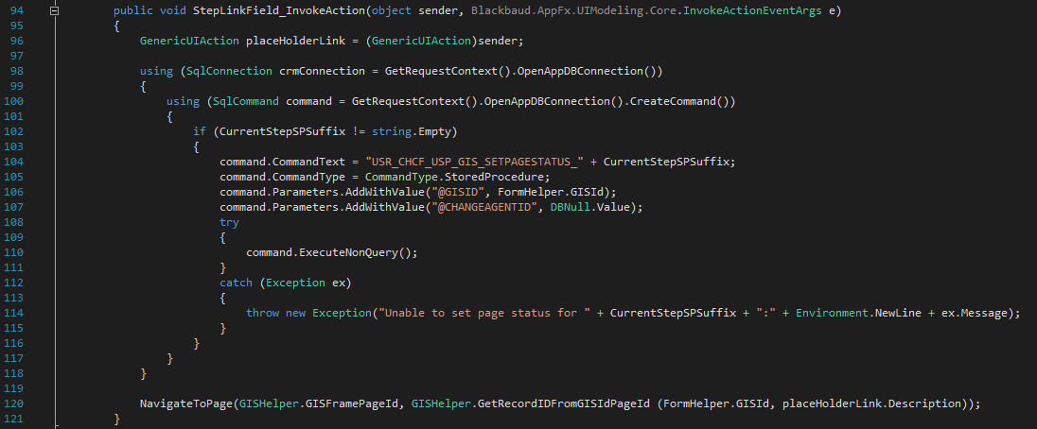
The Custom UI Model data form in the Summary Section
Notes:
The last thing to review regarding the page header is the handler of the InvokeAction event on the UI Actions
** Basically what happens when a User Clicks on an Enabled Step link
** This is the Method we set to Handle all the InvokeAction events for all visible Step UI Actions
**The first thing we do is save the sender, which is the UI Action that was clicked
** Next we call a sproc to update the page status in the PAGE STATUS table for the CURRENT page. This is determined using the CurrentStepSuffix Property that we set in the last slide.
The sproc will also Update Statuses for Every Other Page that depends on the Data Entered in the Current page. This is important, because when we do the page refresh below, the Page Header will be updated from the PAGE STATUS table.
The ValueChanged event fires before this event and the form data is saved prior to the InvokeAction event
**Next we use the UI Model method NavigateToPage to Refresh the Page, Updating the Compound Record ID in the Query String to include the Step ID Corresponding to the Step that was Clicked.
If you recall, we placed the Page/Step ID in the Description property of all the UIActions (placeHolderLink.Description)
The method GetRecordIDFromGISIdPageId creates the compound record id

Slide 27
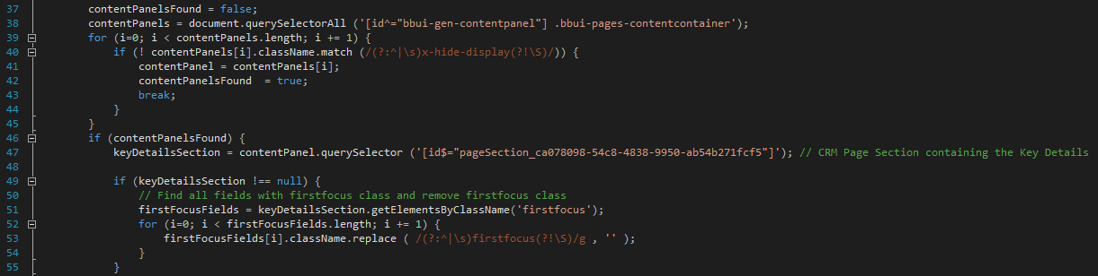
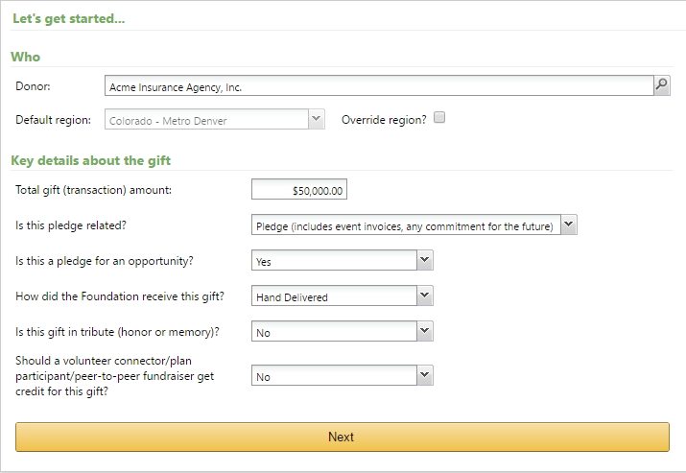
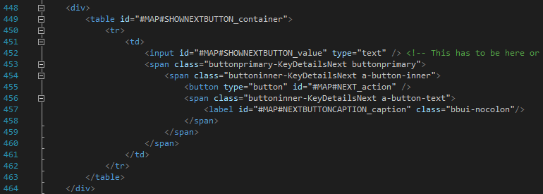
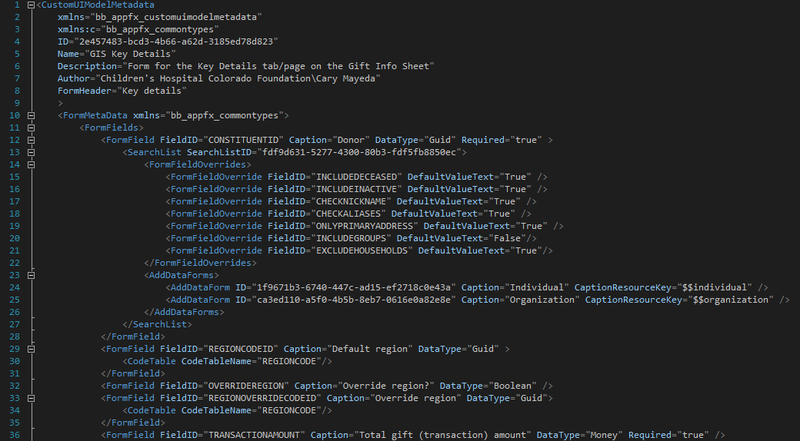
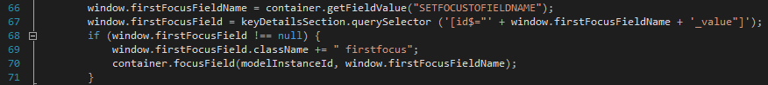
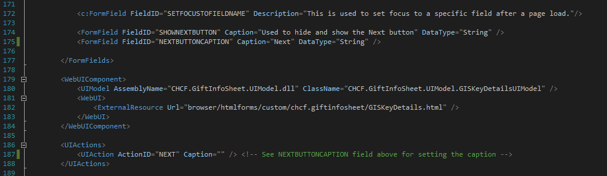
The Custom UI Model data form in the Tab Section
Tab Section
Custom UI Model
Notes:
Now let’s turn our attention to the Custom UI Model data form used in the Tab Section
**
This is the spec for the Custom UI Model data form
As we stated before, there are no stored procedures associated with a Custom UI Model data form
Other than that it’s basically the same as any other data form spec.
** Let’s scroll to the bottom of the spec
** Here we have a field called SETFOCUSTOFIELDNAME
Since we are using Page Refreshes after Fields that impact the Status of other Steps Change, we ran into an issue with CRM.
CRM provides a UI Model method called SetFocusToField that will change the field on the form that has focus. This works most of the time.
The problem is that due to the multi-threaded aspect of the page load, you can call SetFocusToField in the Loaded event, and it actually does change the focus for a split second
And then most of the time another method fires after the Loaded event and resets the focus to the first field.
We also tried using the ‘first focus’ css class, but that didn’t work either as the same method would also set the first field on the form to have the ‘first focus’ css class and when multiple fields are assigned the ‘firstfocus’ class, the first field wins, which was not our field.
** So, finally we wrote a Javascript function that fires after the page is rendered, so it runs after the “Bad” CRM method that resets the focus to the first field.
Basically we remove the ‘firstfocus’ class from any field that has it and add it to the Field whose Name is the Value of the SETFOCUSTOFIELDNAME field.
** First we have to find the correct content panel. There can be many content panels that have a class of x-hide-display that are not visible, but still exist. I think it’s for caching but you’d have to ask product development on that one.
You can then find your Section through the Section ID Guid.
** Now we can remove the ‘firstfocus’ class from any field that has it
** and Add it to the Field whose Name is the Value of the SETFOCUSTOFIELDNAME field .
Problem Solved!
** Next we have the Fields and UI Action, which handle the style and functioning of the Next button
** Here is the HTML for the button
** Using the SHOWNEXTBUTTON_container as the id for the table allows us to hide the button using the Visible property on the SHOWNEXTBUTTON field
** One thing to note is that the Input text box for the value needs to reside some where in this table. I’m hiding this object.
** Next we are using the caption from the NEXBUTTONCAPTION field to display the caption on the button.
The CSS on these classes are about three pages, so I won’t show them here.

Slide 28
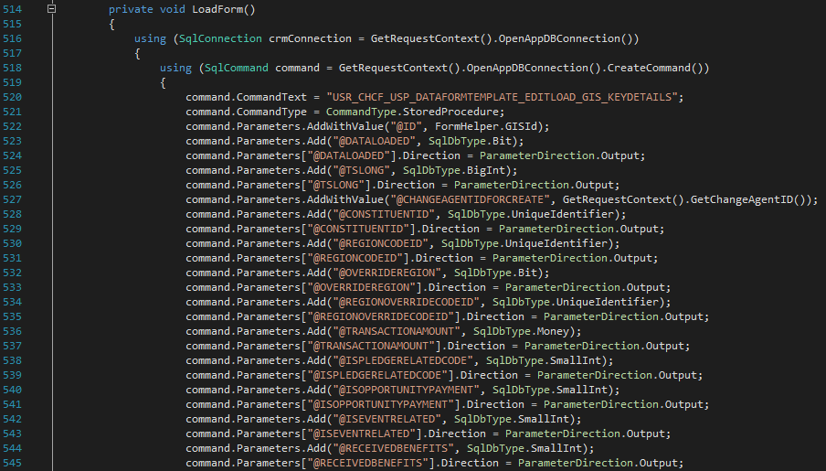
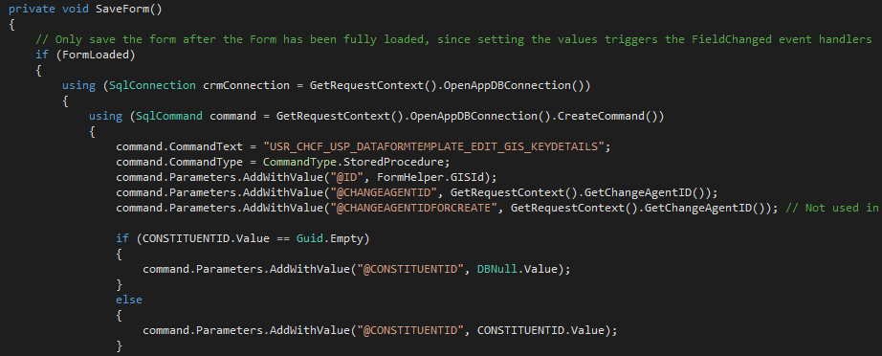
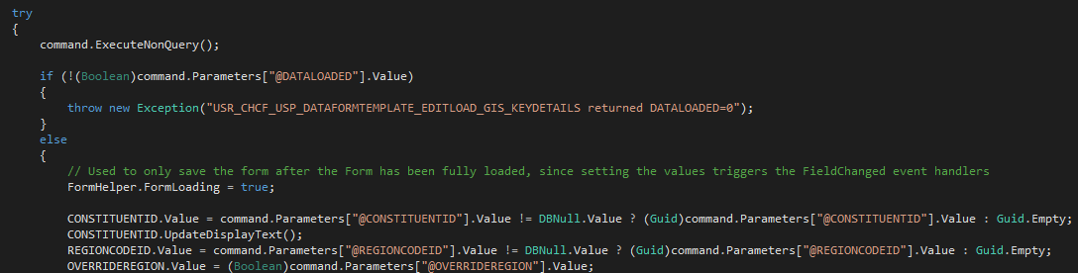
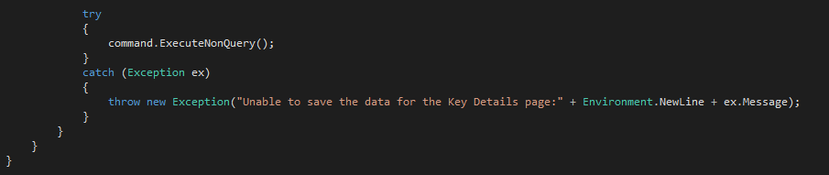
The Custom UI Model data form in the Tab Section
Notes:
Now that we have the form spec we generate the UI Model class for it.
Note: You cannot do a load spec on the Custom UI Model Class.
I’m going to go through the loading of data quickly for the sake of time, since it’s pretty basic.
**You need to create a sproc to retrieve the data and execute the spoc in the code behind
I found the easiest way to create the sproc was to use the CRUD wizard to generate an edit form, which includes the EDITLOAD create statement. You can also use the “EDIT” sproc to perform the save as we’ll see in a moment.
These are the first 14 parameters on the sproc
** Then we do an ExecuteNonQuery and set the field values to the output parameter values
**The SaveForm uses the EDIT sproc from the Edit form.
We do the reverse, set the parameters to the values of the fields (this are the first 4 fields)
**And then do an ExecuteNonQuery and we’re done.
At first we ran the SaveForm method when the user clicked the Next button or one of the Step links. However, unlike standard add/edit forms, the Custom UI Model data forms are not modal, so the user could click anywhere else that would move away from the form and they would lose the data.
So we came to the decision that we would call SaveForm every time a field on the form changed.
We kept each separate data set small, and did some load testing with millions of rows and found that the overhead of this was pretty negligible.

Slide 29
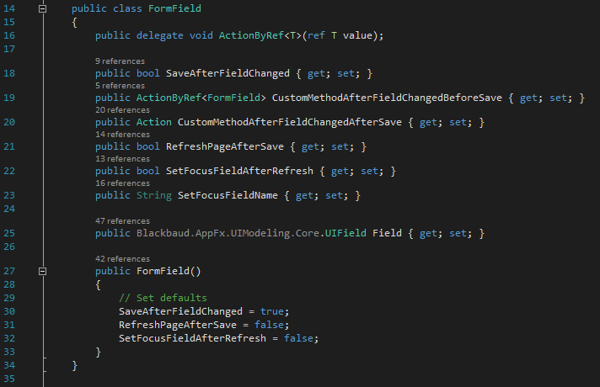
Helper class to Handle ValueChanged events
Notes:
In order to simplify the code on each page, we created a helper class that would handle the field ValueChanged events.
This is the class FormField
We instantiate an instance of this class for Every Field on the Form that can Trigger a ValueChanged event.
We set some defaults to minimize set-up needed for each form with the most common settings.

Slide 30
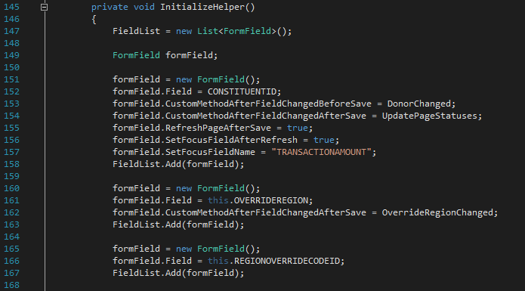
Helper class to Handle ValueChanged events
Notes:
Here is the initialization of the Helper class in the Custom UI Model data form.
We are going to pass it a list of instances of the class FormField that we just looked at. One instance per field.
**The field CONSTITUENTID is one of the more complex situations.
We are telling the helper that we want to call the DonorChanged method on UI Model data form class prior to calling the SaveForm method, which resets all the Constituent related fields on all the Steps (e.g. Region Code, Recognition Credits, …)
After the SaveForm method is run, we want to call the UpdatePageStatuses
Next we want to Refresh the Page after we run UpdatePageStatuses, since we updated the data in so many of the Steps in the sproc we ran before the Save.
Lastly we want to set focus to the field TRANSACTIONAMOUNT
The next two fields are much simpler.
** The OVERRIDEREGION, just calls a method after the save,
** which hides/shows the REGIONOVERRIDECODEID field, which just does the default call of SaveForm.
We do the same for all the fields
**and then we instantiate the Helper class and pass it the UIModel, the List of FormFields we just created. We also pass in the NEXT button just because I was lazy. I’ll automate the finding of the NEXT button in the next release.

Slide 31
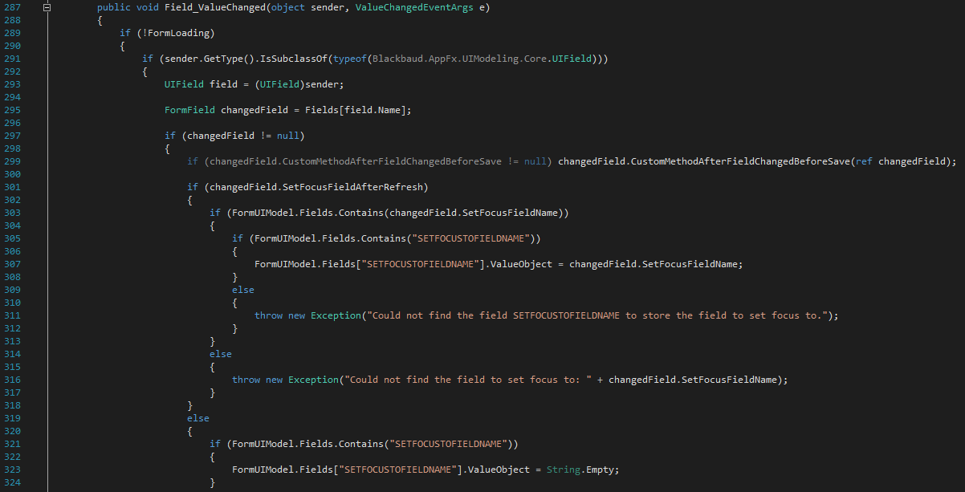
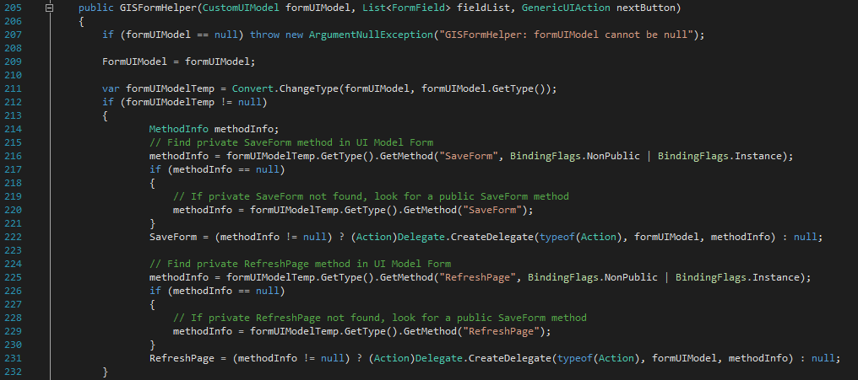
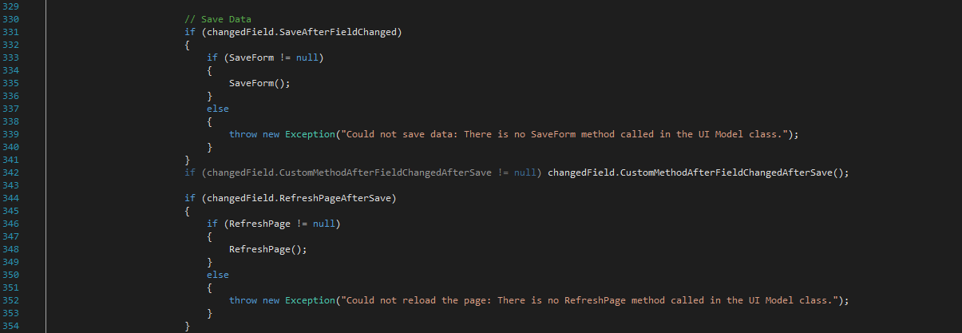
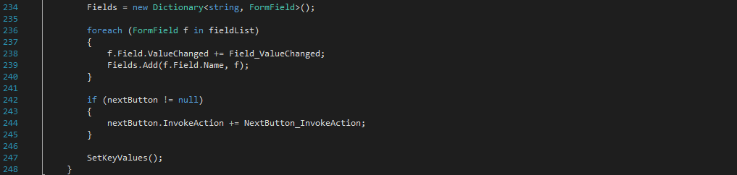
Helper class to Handle ValueChanged events
Notes:
Here is the beginning of the Constructor for the Helper class.
All this is doing is getting Delegates of the SaveForm and RefreshPage methods on the Custom UI Model class that called the Constructor.
**Next we step through the FormField List
** We set the ValueChanged Handler for every FormField to a method in the Helper class – Field_ValueChanged
** And we populate a dictionary with the Field name and the FormField object.
** Here is the Field_ValueChanged method that we just set to handle the ValueChanged events on all the fields.
** We locate our FormField instance by using the Dictionary we populated in the Constructor and the Name of the Sender of the ValueChanged Event.
** Now we can use our FormField class to call the Method to be run BEFORE the Save is performed if it was specified.
** Set the the field SETFOCUSFIELDNAME if it was specified or set it to blank.
This is done before the Save, because it actually gets saved to the DB. This is another place where our single user per record assumption simplifies the code.
** Moving down in the Method
** We call SaveForm on the UI Model
** Call the Method to be run After the Save is performed if it was specified.
** Finally we call set the Refresh Method on the UI Model if that was specified.
All Custom UI Model forms are set up in the same way.

Slide 32
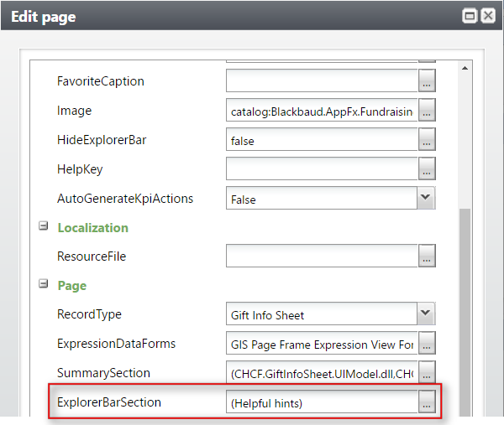
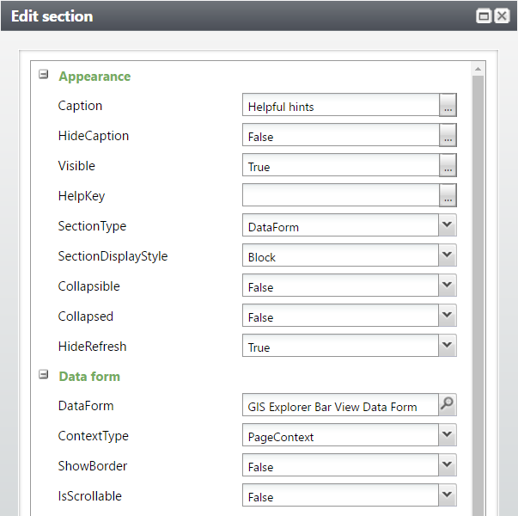
Helpful Hints
Explorer Bar Section
View Data Form
Notes:
Lastly, we’ll look at how the Helpful Hints is implemented using the Explorer Bar Section.
** You can see this on the Page properties
** I’m just using a View Data Form

Slide 33
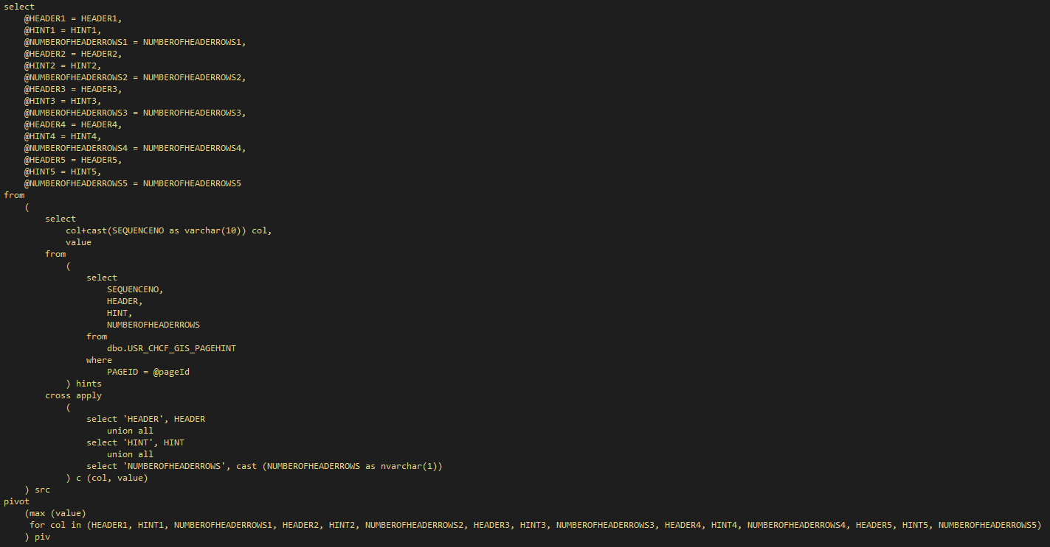
Helpful Hints View Form
Notes:
The View form pulls from the configuration tables and has a maximum of 5 per page.
I pivot the rows returned to populate 5 sets of values that are displayed in the form.
And I use a UI Model to render the Hints as you see them.

Slide 34
Helpful Hints
Explorer Bar Section
View Data Form
Notes:
One thing to note on the Explorer Bar Section.
For some reason CRM would sometimes fail to render the View Form in the Explorer Bar Section.
**However, when I added a Page Action (Validate GIS) it always renders the View Form.

Slide 35
Questions?

Slide 36


Thank you!
cmayeda@childrenscoloradofoundation.org

